Slide 1
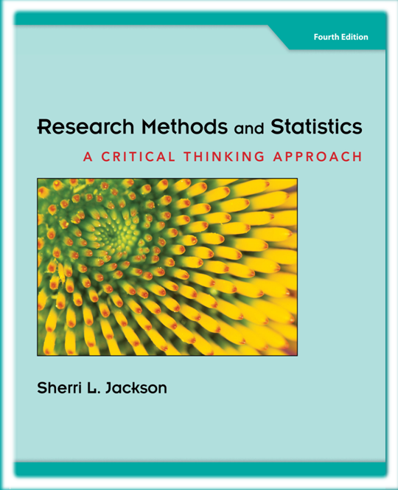


Chapter 6
Correlation
Methods and
Statistics
@ 2012 Wadsworth, Cengage Learning

Slide 2
Topics
Conducting Correlational Research
Magnitude, Scatterplots, and Types of Relationships
Misinterpreting Correlations
Prediction and Correlation
Statistical Analysis: Correlation Coefficients
Advanced Correlational Techniques: Regression Analysis

Slide 3
Conducting Correlational Research

Slide 4
Conducting Correlational Research
Determine whether two variables are related to each other
  Example: do people who are taller tend to weigh more?
Allow us to make predictions from one variable to another
  Example: estimate an individual’s weight based on height

Slide 5
Conducting Correlational Research (cont’d.)
Reasons
  Ethically impossible to do an experimental study
  Useful in measuring many variables and assessing the relationships between them

Slide 6
Magnitude, Scatterplots, and Types of Relationships

Slide 7
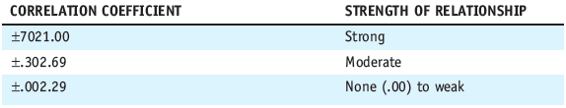
Magnitude, Scatterplots, and
Types of Relationships
Magnitude: an indication of the strength of the relationship between two variables
Table 6.1 Estimates for Weak, Moderate, and Strong Correlation Coefficients

Slide 8
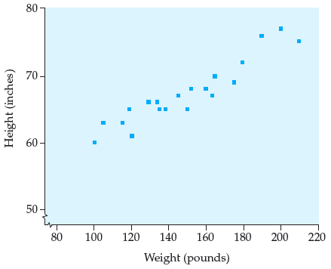
Magnitude, Scatterplots, and
Types of Relationships (cont’d.)
Scatterplot: a figure that graphically represents the relationship between two variables
Figure 6.1 Scatterplot for height and weight

Slide 9
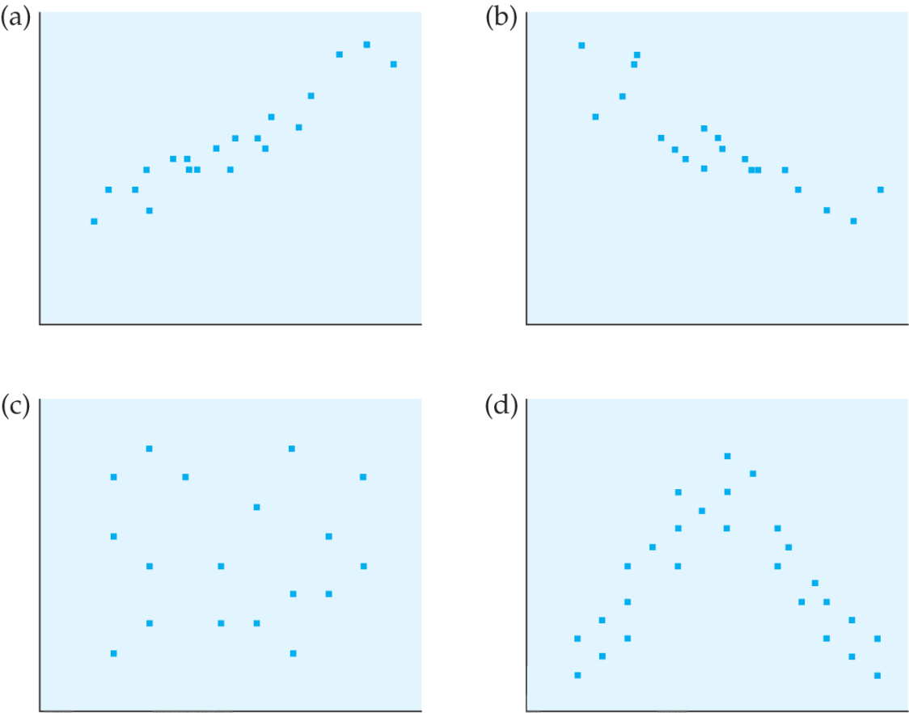
Magnitude, Scatterplots, and
Types of Relationships (cont’d.)
Figure 6.2 Possible types of correlational relationships:
(a) positive; (b) negative; (c) none; (d) curvilinear

Slide 10
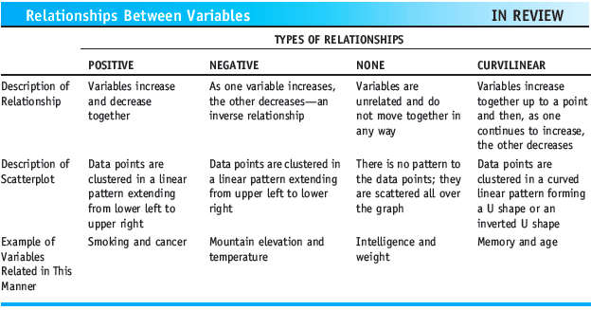
Magnitude, Scatterplots, and
Types of Relationships (cont’d.)
Relationships Between Variables

Slide 11
Misinterpreting Correlations

Slide 12
The Assumptions of
Causality and Directionality
Causality: the assumption that a correlation indicates a causal relationship between the two variables
Directionality: the inference made with respect to the direction of a causal relationship between two variables

Slide 13
The Third-Variable Problem
The problem of a correlation between two variables being dependent on another (third) variable
Partial correlation
  A correlational technique that involves measuring three variables and then statistically removing the effect of the third variable from the correlation of the remaining two variables

Slide 14
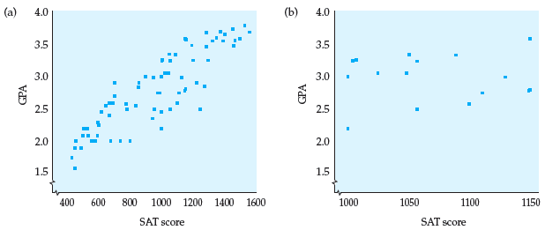
Restrictive Range
A variable that is truncated and has limited variability
Figure 6.3 Restricted range and correlation

Slide 15
Curvilinear Relationships
When a correlation coefficient does not adequately indicate the degree of relationship between the variables

Slide 16
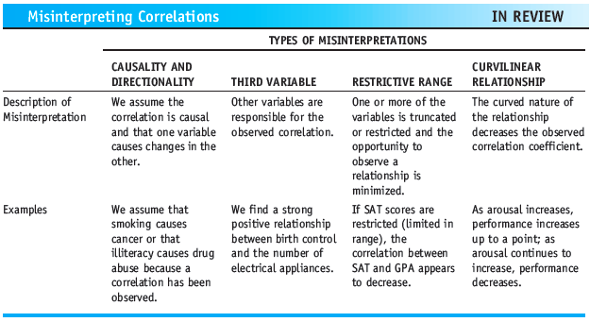
Misinterpreting Correlations (cont’d.)
Misinterpreting Correlations

Slide 17
Prediction and Correlation

Slide 18
Prediction and Correlation
Example:
  Strong positive correlation between smoking and cancer
  You may know someone who has smoked for 30 years and does not have cancer
Person-who argument
  Arguing that a well-established statistical trend is invalid because we know a “person who” went against the trend

Slide 19
Statistical Analysis:
Correlation Coefficients

Slide 20

Statistical Analysis:
Correlation Coefficients
Pearson product-moment correlation coefficient (Pearson’s r)
  The most commonly used correlation coefficient when both variables are measured on an interval or ratio scale
Formula for Pearson’s r:

Slide 21
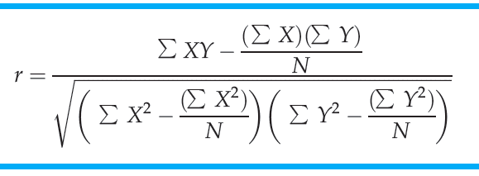
Statistical Analysis:
Correlation Coefficients (cont’d.)
Table 6.4 Computational Formula for Pearson’s Product-Moment Correlation Coefficient

Slide 22
Statistical Analysis:
Correlation Coefficients (cont’d.)
Coefficient of determination (r²)
  A measure of the proportion of the variance in one variable that is accounted for by another variable
  Calculated by squaring the correlation coefficient

Slide 23
Statistical Analysis:
Correlation Coefficients (cont’d.)
Spearman’s rank-order correlation coefficient
  The correlation coefficient used when one (or more) of the variables is measured on an ordinal (ranking) scale
Point-biserial correlation coefficient
  The correlation coefficient used when one of the variables is measured on a dichotomous nominal scale and the other is measured on an interval or ratio scale

Slide 24
Statistical Analysis:
Correlation Coefficients (cont’d.)
Phi coefficient: the correlation coefficient used when both measured variables are dichotomous and nominal

Slide 25
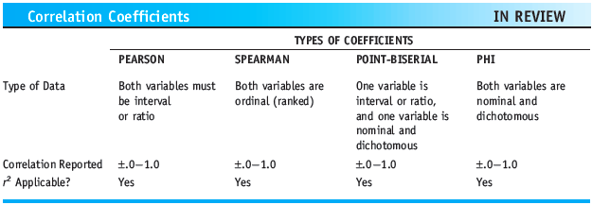
Statistical Analysis:
Correlation Coefficients (cont’d.)
Correlation Coefficients

Slide 26
Advanced Correlational Techniques: Regression Analysis

Slide 27
Advanced Correlational Techniques: Regression Analysis
Regression analysis
  A procedure that allows us to predict an individual’s score on one variable based on knowing one or more other variables
Regression line
  The best-fitting straight line drawn through the center of a scatterplot
  Indicates the relationship between the variables height and weight for this group of individuals

Slide 28
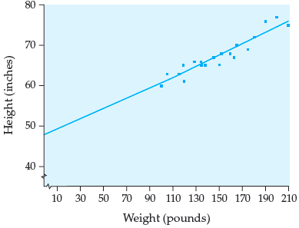
Regression Analysis (cont’d.)
Figure 6.4 The relationship between height
and weight with the regression line indicated

Slide 29
Summary
Correlations vary in type and magnitude
Errors are commonly made when interpreting correlations
Correlation coefficients: Pearson’s, Spearman’s, point-biserial, and phi
Coefficient of determination and regression analysis provide a tool for predicting from one variable to another

